Slide 1

MES 503 Lab 10
Kayla Blincow, PhD

Slide 2

Announcements
Quiz today!
Lab Assignment 4 Posted
  Due next Thursday
Working on grading assignment 3
Office hours tomorrow?

Slide 3
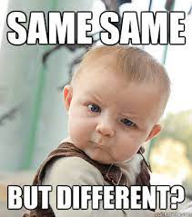
ANCOVA
Special case of multiple linear regression
Limited to having one categorical and (usually) one continuous independent variable
  Usually run in the context of wanting to know about differences in the categorical variable but the continuous variable is confounding
  NO interaction effects allowed!

Slide 4
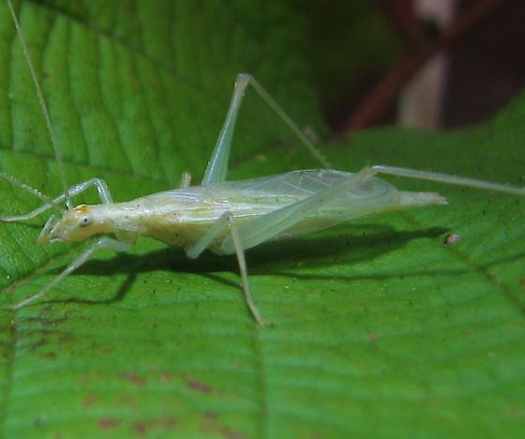
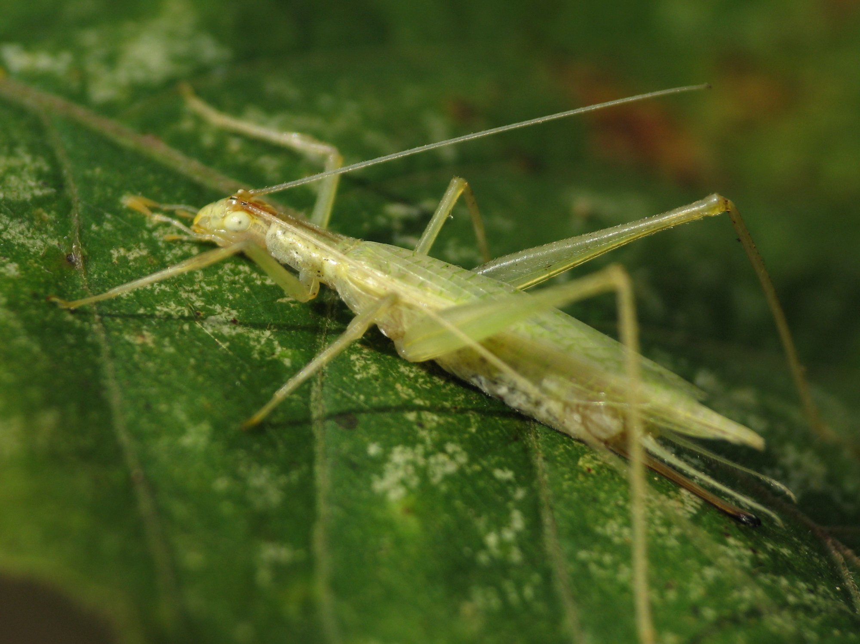
Scenario: Crickets!
We are researchers studying two cricket species, Oecanthus exclamationis and Oecanthus niveus.
We want to see if the pulse rates of their songs are different, because we suspect that females of the different species identify mates based on pulse rate.
However, song pulses are known to be affected by temperature.

Slide 5

Switch to code!

Slide 6
Additional Resources
ANCOVA in R: Control a Covariate, Gain Power

